Slide 1
Projektna prezentacija: Elementarni postupak diferencijalnog praćenja
Josip Milić
Članovi grupe projekta:
Kristijan Biščanić, Matej Djerdji, Ivan Fabijanić, Dario Pažin i Josip Milić
Zagreb, 21.01.2014.

Slide 2

Računalni vid

Slide 3
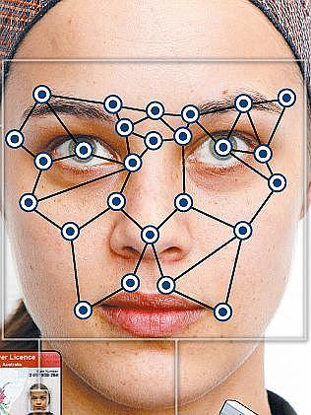
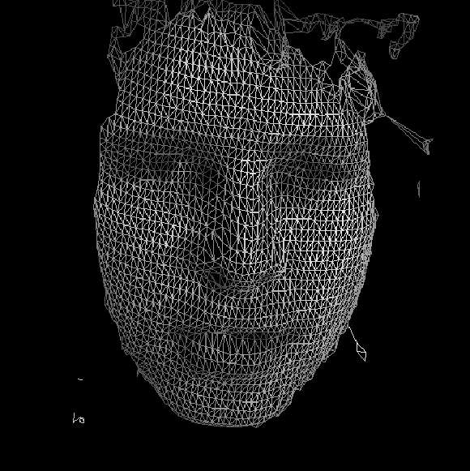
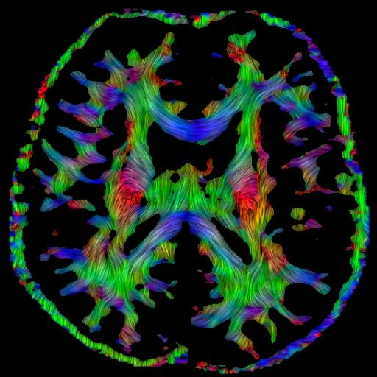
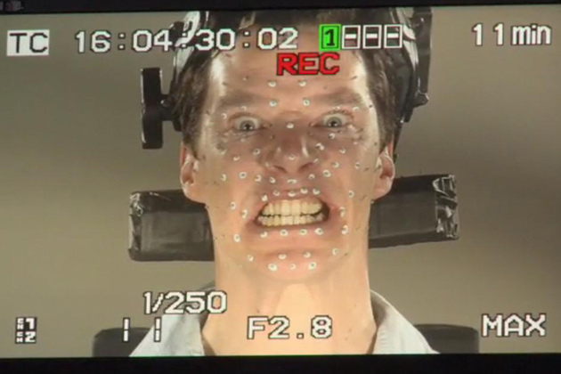
Računalni vid

Slide 4
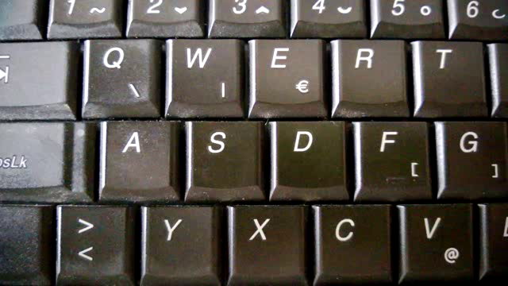
Obrada slike

Slide 5

Obrada slike

Slide 6
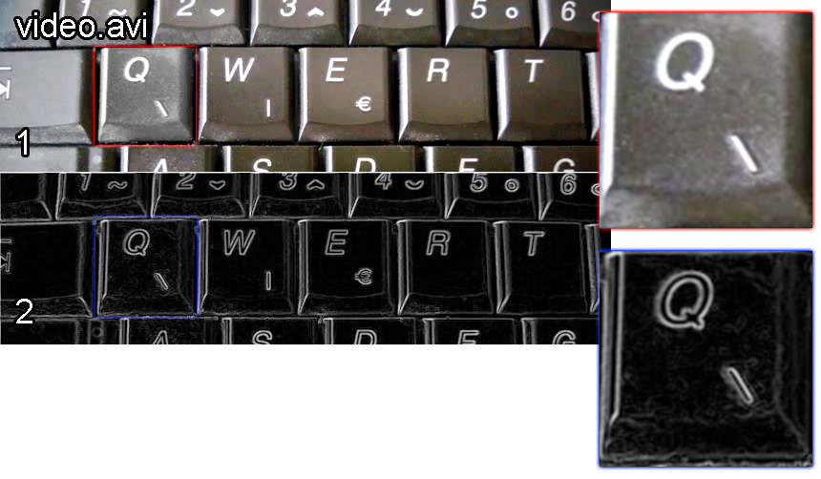
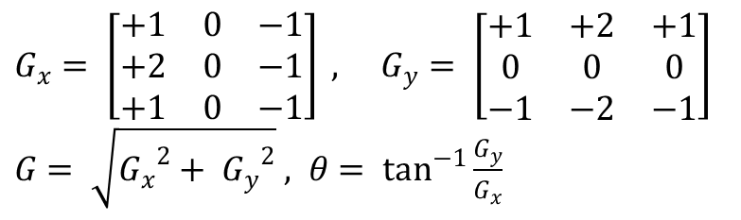
Obrada slike: računanje gradijenta
$G_{x}= \left[\begin{matrix}+1 & 0 & −1 \\ +2 & 0 & −1 \\ +1 & 0 & −1\end{matrix}\right] , G_{y}= \left[\begin{matrix}+1 & +2 & +1 \\ 0 & 0 & 0 \\ −1 & −2 & −1\end{matrix}\right]$
$G= \sqrt{{G_{x}}^{2}+ {G_{y}}^{2}} , θ= \tan^{−1}{\frac{G_{y}}{G_{x}}}$

Slide 7
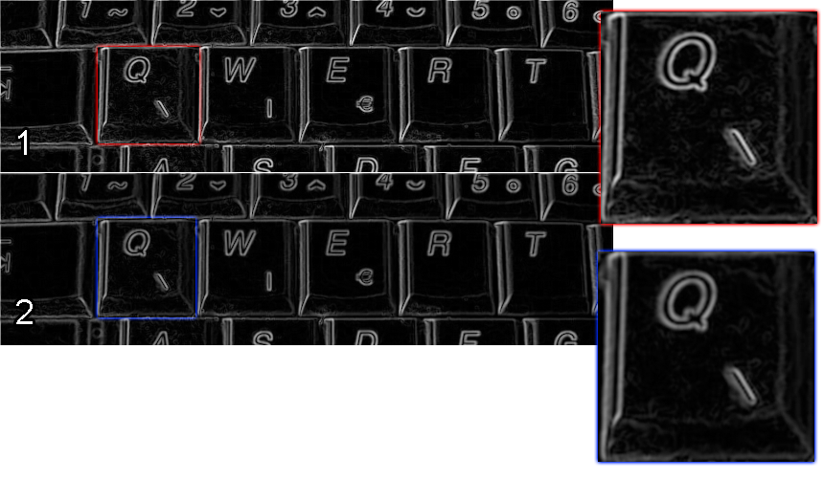

Obrada slike: zaglađivanje
$G\left(x, y\right)= \frac{1}{2πσ^{2}}e^{−\frac{x^{2}+ y^{2}}{2σ^{2}}}$
$k=2∗ \left\lfloor 3σ\right\rfloor +1$

Slide 8
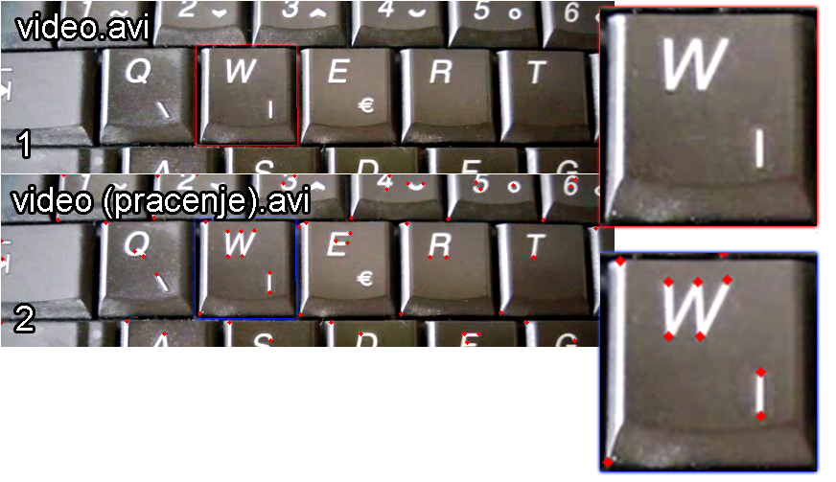
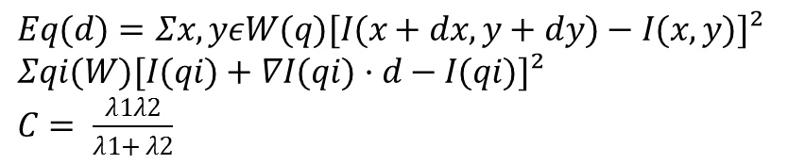
Harrisovi kutovi
$Eq(d)=Σx,yεW(q)[I(x+dx,y+dy)−I(x,y)]²$
$Σqi(W)[I(qi)+∇I(qi)·d−I(qi)]²$
$C= \frac{λ1λ2}{λ1+ λ2}$

Slide 9
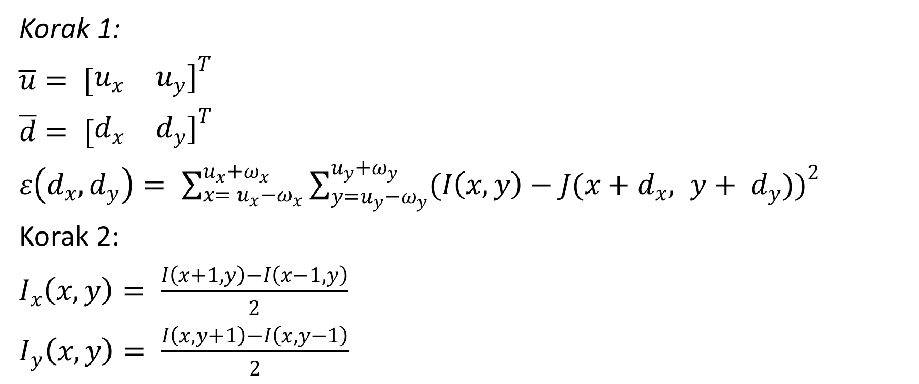
KLT algoritam
Korak 1:
$\overline{u}= {[\begin{matrix}u_{x} & u_{y}]\end{matrix}}^{T}$
$\overline{d}= {[\begin{matrix}d_{x} & d_{y}]\end{matrix}}^{T}$
$ε\left(d_{x},d_{y}\right)= \sum_{x= u_{x}−ω_{x}}^{u_{x}+ω_{x}}{\sum_{y=u_{y}−ω_{y}}^{u_{y}+ω_{y}}{(I\left(x,y\right)−J(x+d_{x}, y+ d_{y})}})^{2}$
Korak 2:
$I_{x}\left(x,y\right)= \frac{I\left(x+1, y\right)−I\left(x−1, y\right)}{2}$
$I_{y}\left(x,y\right)= \frac{I\left(x, y+1\right)−I\left(x, y−1\right)}{2}$

Slide 10

KLT algoritam
Korak 3:
$H=\sum_{x=u_{x}−ω_{x}}^{u_{x}+ω_{x}}{\sum_{y=u_{y}−ω_{y}}^{u_{y}+ω_{y}}{\left[\begin{matrix}I_{x}^{2}(x,y) & I_{x}(x,y)I_{y}(x,y) \\ I_{x}(x,y)I_{y}(x,y) & I_{y}^{2}(x,y)\end{matrix}\right]}}$
Korak 4:
$\overline{d}= {[\begin{matrix}0 & 0]\end{matrix}}^{T}$

Slide 11

KLT algoritam
Korak 5: <=K
${δI}_{k}\left(x,y\right)=I\left(x,y\right)−J(x+d_{x}, y+ d_{y})$
${\overline{b}}_{k}=\sum_{x=u_{x}−ω_{x}}^{u_{x}+ω_{x}}{\sum_{y=u_{y}−ω_{y}}^{u_{y}+ω_{y}}{\left[\begin{matrix}δI_{k}(x,y)I_{x}(x,y) \\ \begin{matrix}δI_{k}(x,y)I_{y}(x,y)\end{matrix}\end{matrix}\right]}}$
${\overline{η}}_{k}=H^{−1}{\overline{b}}_{k}$ ${\overline{d}}_{k}= d_{k−1}+{\overline{η}}_{k}$
$v=u+d$

Slide 12
Prezentacija rezultata

